Slide 1
IITG HOSPITAL MANAGEMENT SYSTEM Instructor: Dr. P. K. Das
Computer Science And Engineering (IITG)
Software Engineering Project
Presentation
GROUP 5

Slide 2
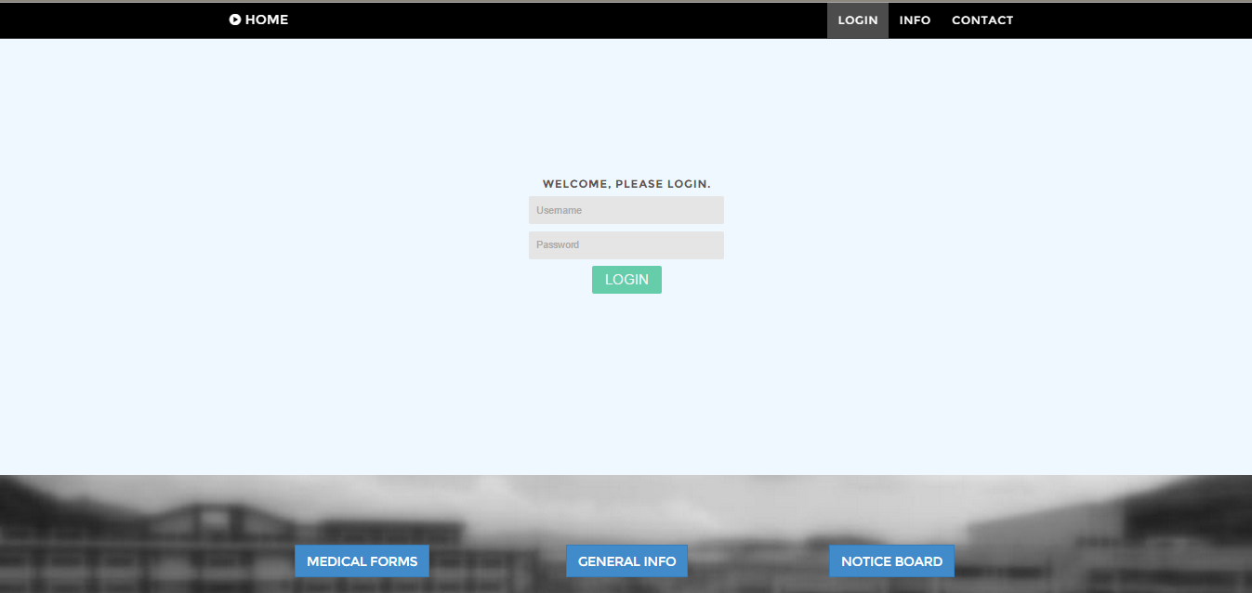
Web app
LOGIN PAGE :-

Slide 3
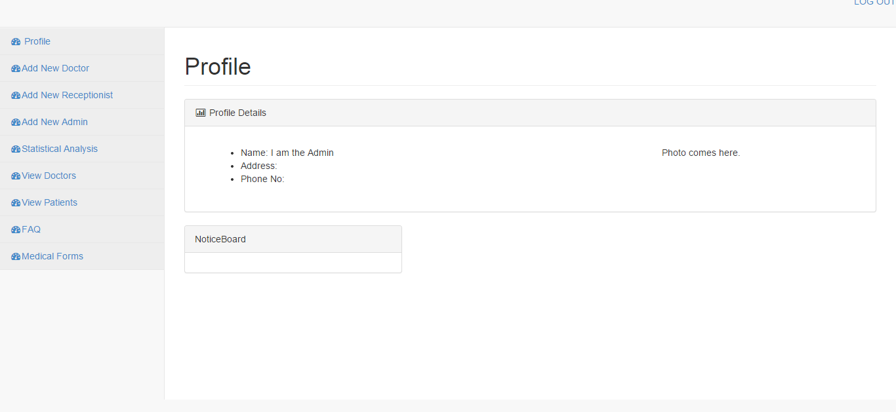
Admin :-
Dash Board :-

Slide 4
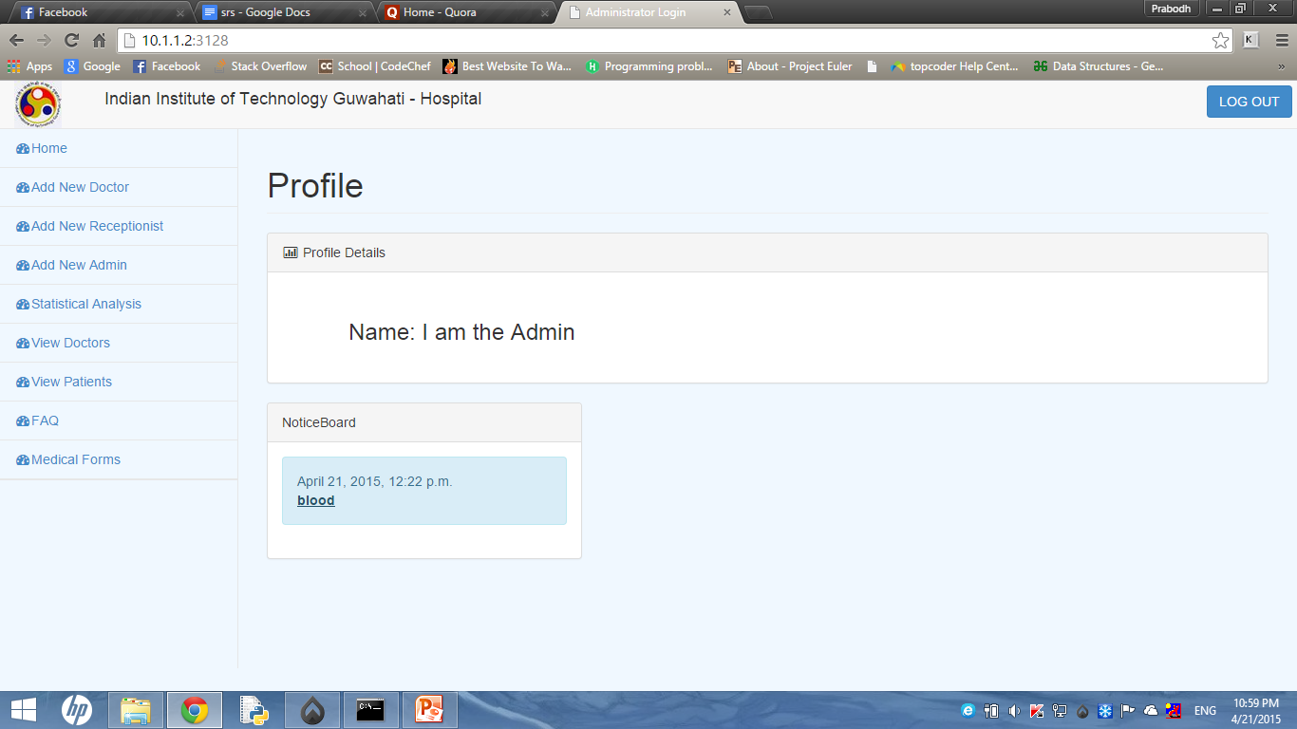
HOME PAGE
This is home page of Admin.
1. It consists of admin details.
2. It also has access to notice-board.

Slide 5
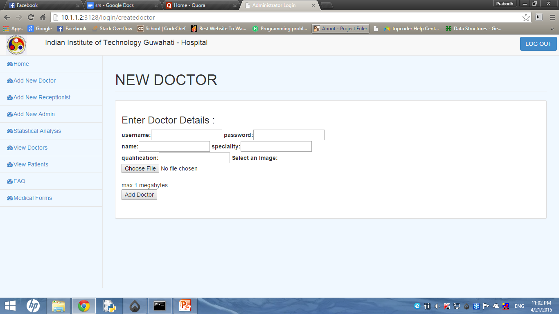
ADD NEW DOCTOR
Functionality of each button:
1. Choose File button : Here admin selects the photograph of doctor. Max. size of photograph is 1MB.
2. Passwords are initially provided by admin, but after confirmation, doctor can change his/her password.
3. Add Doctor Button: All the information provided by admin is then uploaded to the database.

Slide 6
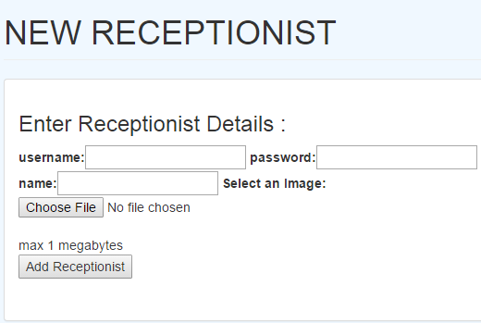
ADD NEW RECEPTIONIST
Functionality of each button:
1. Choose File button : Here admin selects the photograph of receptionist. Max. size of photograph is 1MB.
2. Passwords are initially provided by admin, but after confirmation, receptionist can change his/her password.
3. Add Receptionist Button: All the information provided by admin is then uploaded to the database.

Slide 7
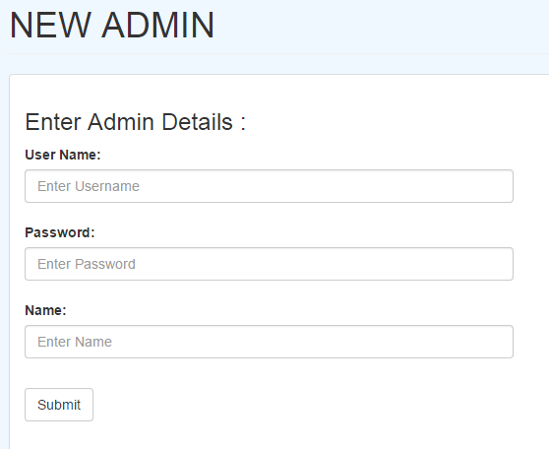
ADD NEW ADMIN
Functionality of each button:
1. Passwords are initially provided by admin, but after confirmation, admin can change his/her password.
2. Submit Button: All the information provided by admin is then uploaded to the database.

Slide 8
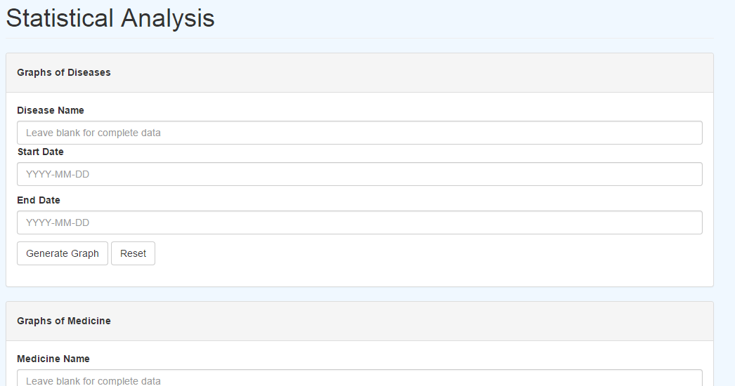
STATISTICAL ANALYSIS
Functionality of each button:
1. It consists of 3 containers (some not visible here) which again consists 2 buttons and text fields.
2. Generate graph: This button redirects to another page where graphs are displayed. Start date and End date fields are optional but Name field (if present) is compulsory.
3. Reset Button: Resets all the values in text field.

Slide 9
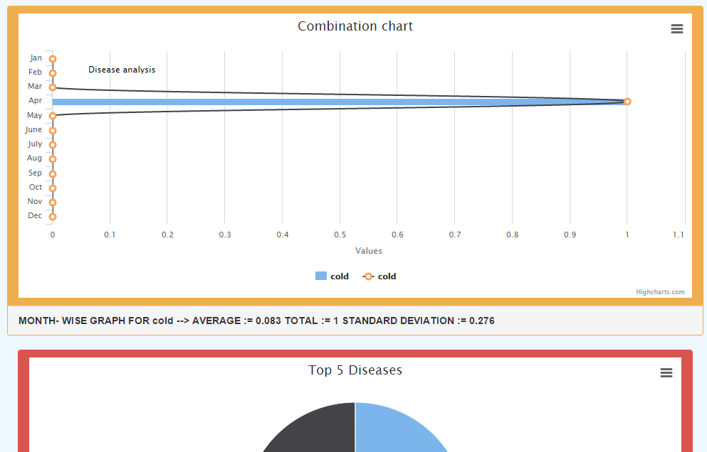
GRAPHS and Word cloud
This page displays graphs and word cloud.
Each graph has button which helps admin download the graph in any format they want.
We used highcharts.js to generate graphs and word clouds were generated from jQCloud.

Slide 10
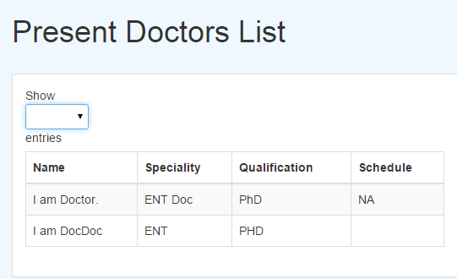
VIEW DOCTORS, PATIENTS LIST
Well as heading says, this button displays all the doctors registered by admin.
Same is the case with view patients list.

Slide 11
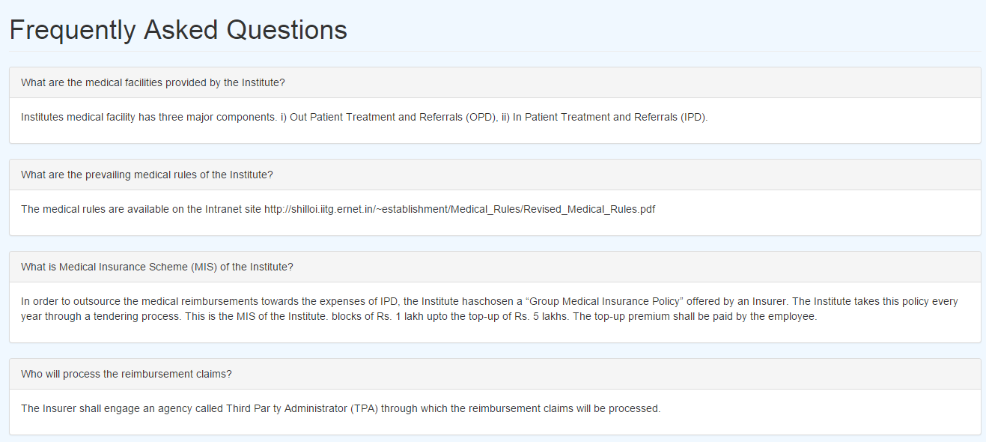
FAQ button
Well this module displays all the Frequently Asked Questions (FAQ).
All these questions were taken from current IITG Hospital website.

Slide 12
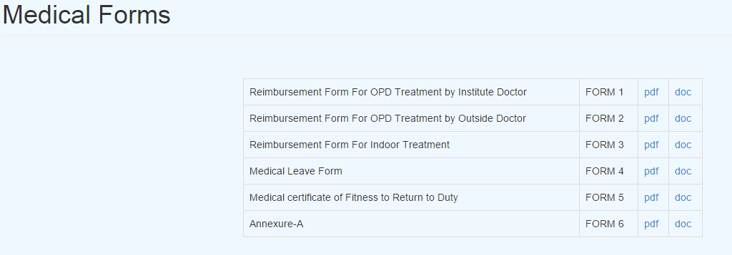
MEDICAL FORMS
This page consists of different forms which can be downloaded in pdf or doc format.

Slide 13
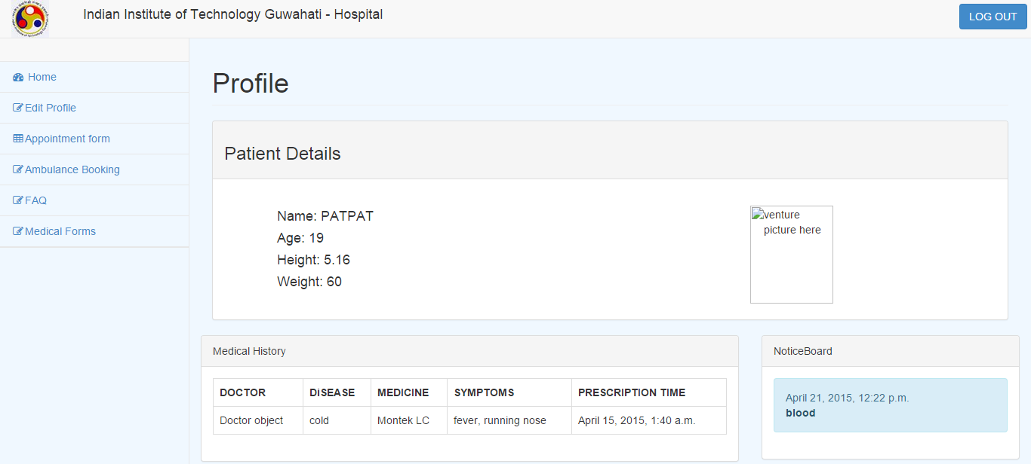
Webapp
Patients
Dash Board -

Slide 14

HOME PAGE
This page displays all the details of patient.
It also displays the history of patient.
It has link to Noticeboard.

Slide 15
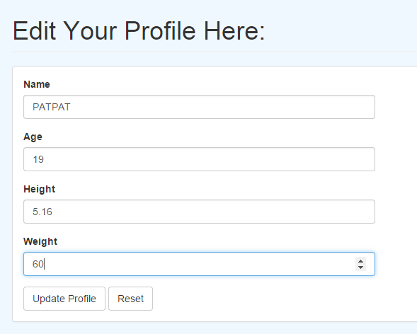
EDIT PROFILE
This module helps in editing the profile of patient (You don’t say).
Update profile button: This button updates database with the information provided in text fields.
Reset Button: This button resets all text fields( You don’t say.).

Slide 16
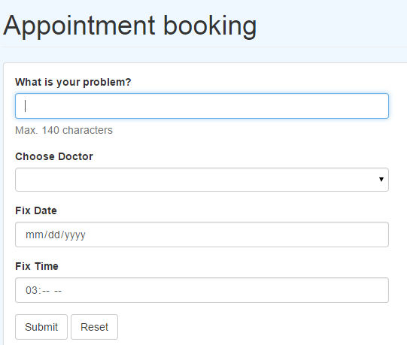
APPOINTMENT BOOKING
This module helps in booking appointment for patient.
Fix time should be within working hours.
Submit button: Submit button books the appointment if possible.
Reset button: This button resets all the fields.

Slide 17
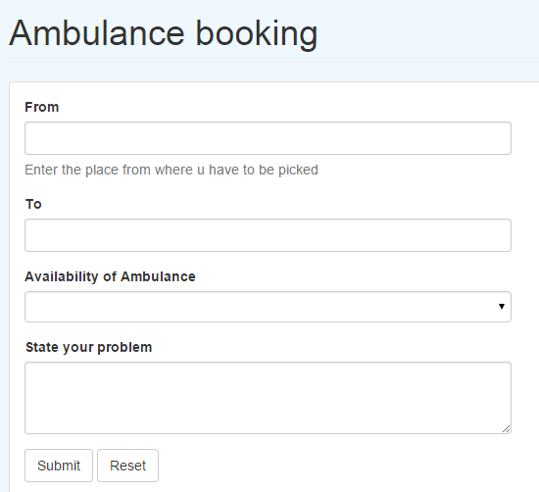
AMBULANCE BOOKING
This module helps patient in booking ambulance.
Maximum of 5 person can be accommodated in ambulance at a time.
Availability of ambulance: This shows whether ambulance is available or not.
Submit button: This button submits the query and updates the database.
Reset button: It resets all the values in text-field.

Slide 18
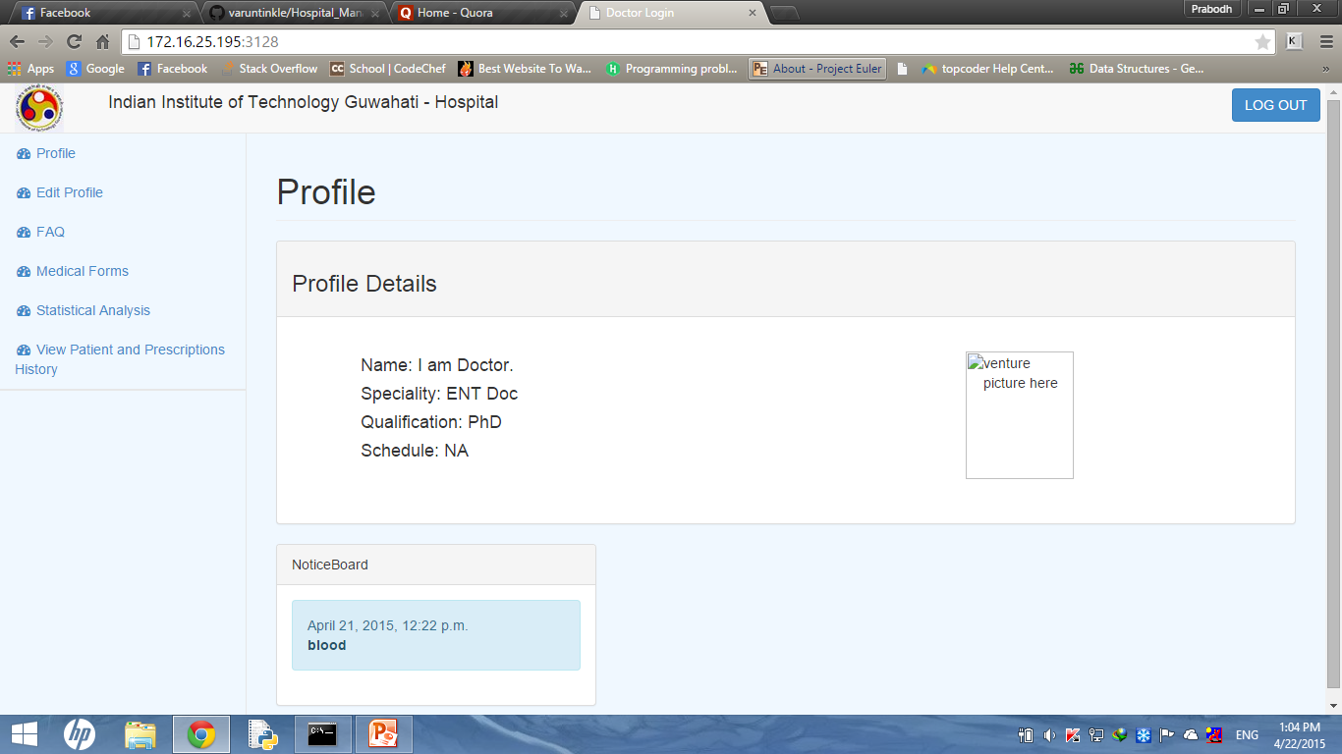
Webapp
Doctor
Dash Board -

Slide 19
HOME PAGE
This is home page of doctor.
It displays all the details of doctor.
It also has link to notice-board.
Functionality of other buttons are same as was stated for other modules.

Slide 20
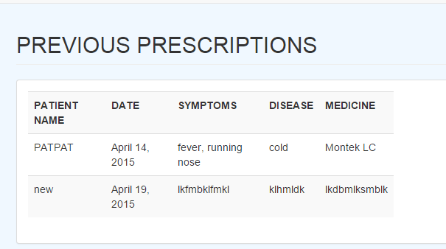
VIEW PATIENT HISTORY
This page displays history of all patients diagnosed by doctor.
This module also has statistical analysis which is same as present in admin page.

Slide 21
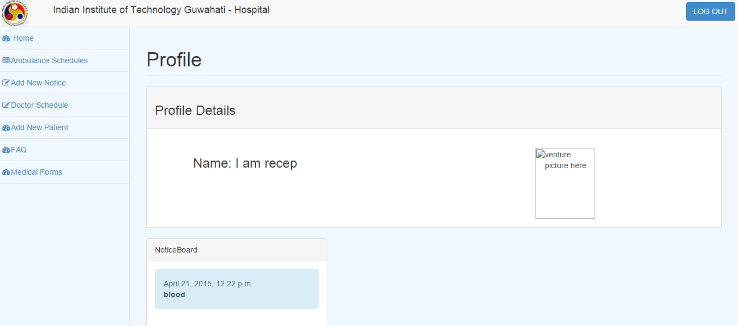
Webapp
Receptionist
Dash Board -

Slide 22
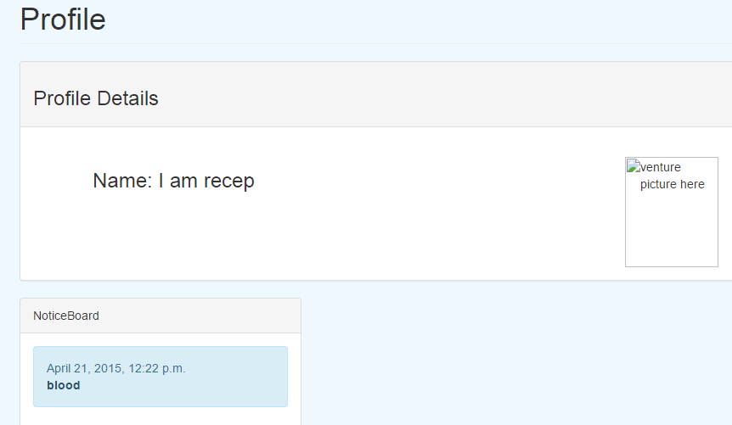
HOME PAGE
This page displays all the details of receptionist.
It also has link to notice board.

Slide 23
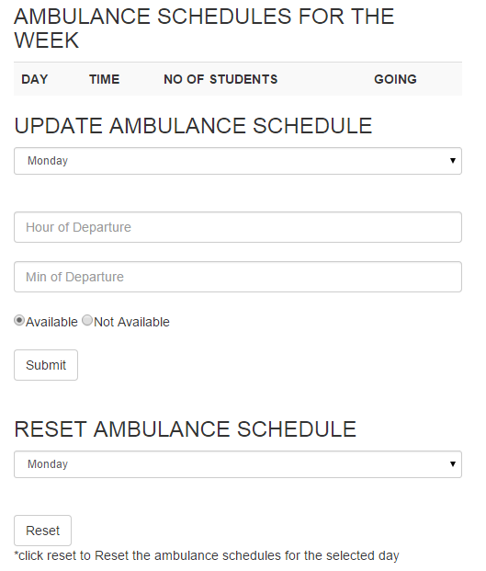
AMBULANCE SCHEDULE
This page displays schedule of ambulance and no. of students in it.
Receptionist can update the ambulance schedule using submit button.
Receptionist also has the power to reset all the ambulance schedule of day.

Slide 24
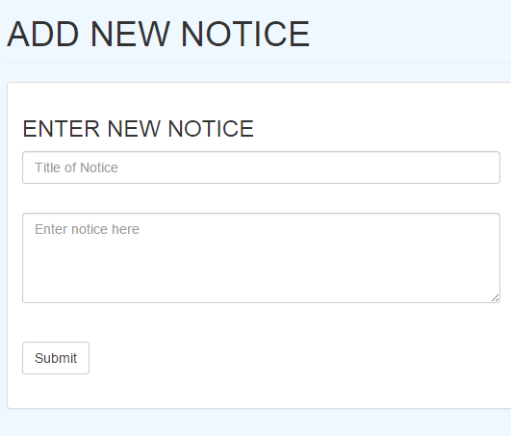
ADD NEW NOTICE
Receptionist can update notice board using this module.
Submit button updates the database and thus notice board page.

Slide 25
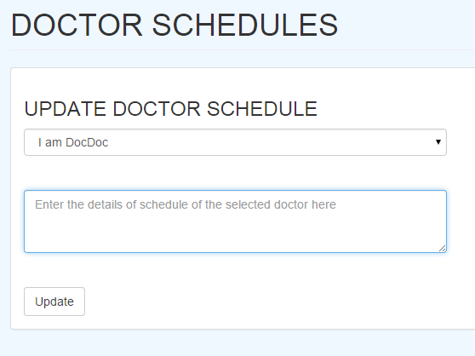
DOCTOR SCHEDULE
This module updates the doctor schedule (No shit.).
Update button: For the doctor as in drop box, his/her schedule gets updated in database.

Slide 26
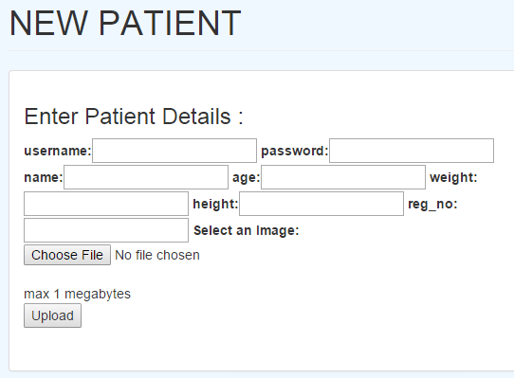
ADD NEW PATIENT
This is the main module for receptionist.
This is where he/she adds patient.
To add patient, this form is first filled and then uploaded.
Upload button: This button updates the data base with information provided in the form.
Rest of the modules are same as in other forms.

Slide 27
Webapp FEATURES
FOR LOGIN :
The page starts with a Login Page where patient, doctor ,receptionist and admin can log in to access the app. In the Login Page, there is also a link provided for notice board, general information and medical forms.
AFTER LOGIN :
1. FOR PATIENTS :
The patient can see his/her details (age ,height ,weight) and can also update that.

Slide 28
Webapp FEATURES
The patient can book an appointment with a doctor specifying the problem ,date and time.
Ambulance booking facility is also provided. The availability of ambulance is also mentioned in that form.
Forms related to medical can be downloaded easily.

Slide 29
Webapp FEATURES
2. FOR ADMIN:
The admin can see the doctors list in which their specialty , qualification and schedule is given . The list gets updated accordingly.
All the details of the patient can be seen by the admin along with their registration number and can check which patient is outsider.
New patients , doctors , and receptionist can be added.
The statistical analysis can be done and see the graph corresponding to medicine and disease.

Slide 30
Webapp FEATURES
3. FOR DOCTORS:
The doctor can see his appointment schedule with the patients.
He can update his timings and schedule.

Slide 31
Webapp FEATURES
4. FOR RECEPTIONIST:
He can see the ambulance schedule and also can update it
New notice related to the hospital can be added by him.
The doctor’s schedule can be updated by him.
For new patients , the receptionist can add him as a new patient.

Slide 32
THANK YOU

